Slide 1
Collaborative Learning with Math Mini-Assessments
Core Advocates Monthly Webinar
June 6, 2018
The webinar will begin shortly. You may wish to download the handouts (check the tab on your webinar control panel) while you wait.
Notes:
Tori first timer poll
Handouts:
While we’re waiting, we’d like you to participate in a quick poll so we can get an understanding of who’s on the webinar with us tonight.

Slide 2
Introductions
Your hosts from the SAP Professional Learning Team
Jennie Beltramini, Math Specialist
Tori Filler, ELA/Literacy Specialist
This Month’s Guests -
Astrid Fossum, Senior Mathematics Specialist
Michelle Douglas-Meyer, Instructional Coach
Notes:
Jennie

Slide 3
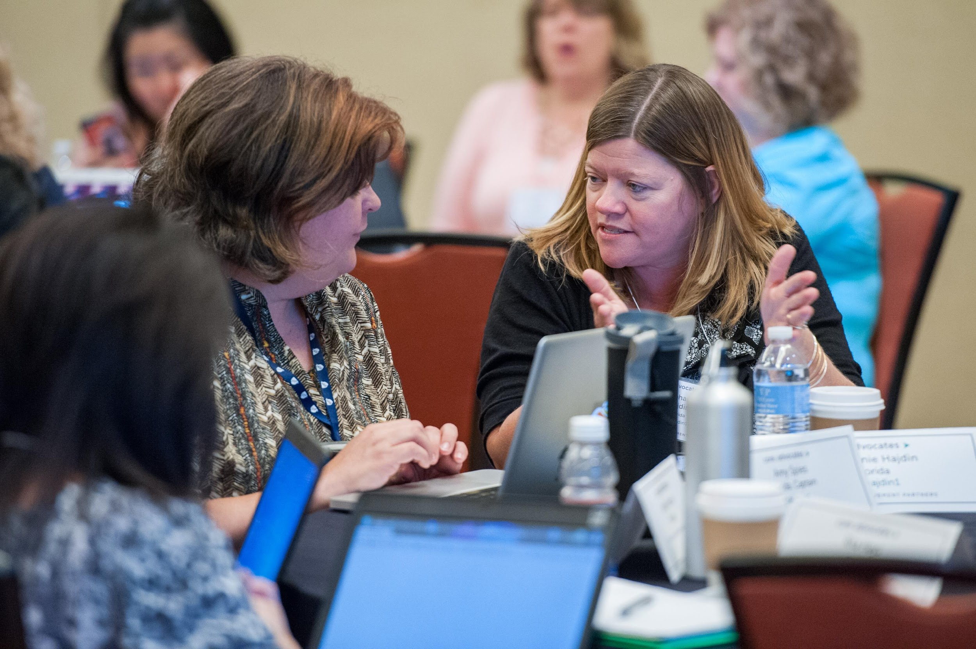
Who are Core Advocates?
Core Advocates are educators who:
  Believe in the potential of high-quality standards to prepare all students for college and careers;
  Are eager to support their colleagues and communities in understanding and advocating for the college- and career-ready standards, and standards-aligned instruction;
  Understand and embrace the Shifts in instruction and assessment required by the college- and career-ready standards
Notes:
Jennie
CAs are teachers from all over the country who believe in the potential of high quality standards and the importance of all students being prepared for college and careers.
They support their colleagues in understanding and advocating for the standards and embrace the Shifts in instruction
The Core Advocate network is over 12K educator strong and we’d love for you to join us if you have not already

Slide 4

Learn more about us!
Contact Jennie Beltramini (jbeltramini@studentsachieve.net)
Complete this survey to join our database (and mailing lists): www.achievethecore.org/ca-signup
Visit our website: www.achievethecore.org
Notes:
Jennie
If you’d like to learn more about the network, contact Joanie or Jennie (their emails are here).
We also want to invite you to join the network by signing up at achievethecore.org/ca-signup and visit our website for more info and opportunities

Slide 5

Tweet with us!
Please feel free to tweet during and after the webinar using #coreadvocates
@achievethecore
@JennieBeltro
@AstridFossum
@mdmeyer
Notes:
Jennie

Slide 6
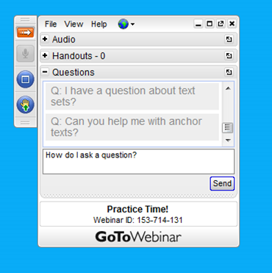
Engage with us!
During the webinar
– Accessing Documents
– Questions option
– Polling
After the webinar
– Survey
– Access to recorded webinar
Notes:
Jennie

Slide 7
Goals of the webinar
Understand how to recognize high-quality assessments aligned to the Shifts required by college- and career-ready standards
Consider Student Achievement Partners’ mini-assessments for mathematics as a model for high-quality, aligned assessments
Learn how educators have used the mini-assessments within a school district and the impact on students, teachers, and achievement.
Notes:
Jennie
We have three main goals for our webinar tonight. They are to...

Slide 8
Section 1: How can we recognize high-quality assessments aligned to the Shifts required by college- and career-ready standards?
Notes:
Tori

Slide 9
Poll:
How familiar are you with next-generation math assessments?
Notes:
Tori
POLL: select one
○o I’ve never utilized next-gen assessments
○o I’m familiar with next-gen assessments but have never used them
○o I have used SAP mini-assessments in my setting
○o I use and write next-gen-type questions

Slide 10



The CCSS Requires Three Shifts in Mathematics
Focus strongly where the standards focus.
Coherence: Think across grades and link to major topics within grades.
Rigor: In major topics, pursue conceptual understanding, procedural skill and fluency, and application with equal intensity.
Notes:
ASTRID
The Shifts provide a frame that describes how the Common Core and other college- and career-readiness standards raise expectations across multiple areas of the educational experience including instructional materials, classroom practice, and assessment. The Shifts illustrate how every standard contributes to transformative changes in the classroom that will better prepare college-and-career-ready students. Now we will look at the Criteria for High –Quality assessment and then cover a comparison of how the Shifts manifest in the Criteria.

Slide 11
How are next generation assessments different?
Focus strongly where the standards focus
From | To
Cover content that is a “mile-wide and an inch-deep” | Assess fewer topics at each grade (as required by the standards)
Give equal importance to all content | Dedicate the large majority of score points to the major work of the grade
Notes:
The first Shift calls for a greater focus in mathematics. Traditionally, U.S. standards were arranged in a way that gave equal importance to four areas (Number and Operations, Measurement and Geometry, Algebra and Functions, and Statistics and Probability) like “shopping aisles.” Each grade would go up and down the aisles, tossing topics into the cart, losing focus.
Rather than racing to cover topics in a mile-wide, inch-deep curriculum, the Standards require us to significantly narrow and deepen the way time and energy is spent in the math classroom. Additionally, many elementary students were dipping into advanced topics at the expense of mastering fundamentals. In this narrowing process, some topics that were covered previously in the grade will continue to be emphasized in that grade. It’s not new mathematics; it’s a new way of emphasizing the most important content for the grade.
We focus deeply on the major work* of each grade so that students can gain strong foundations: solid conceptual understanding, a high degree of procedural skill and fluency, and the ability to apply the math they know to solve problems inside and outside the math classroom.
*For a list of major, supporting, and additional clusters by grade, please refer to ‘Where to focus by grade level” at http://achievethecore.org/shifts-mathematics.

Slide 12

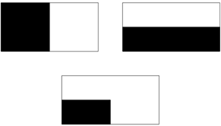
Traditional vs. Next Gen Approach
Traditional Assessment Question: Grade 2 Geometry
Traditional Assessment Question: Grade 2 Geometry
Shawn cut a rectangle along two lines of symmetry. How many equal shares will he have?
Aligned Item: 2.G.A.3
Ms Nim gave her students a picture of a rectangle. Then she asked them to shade in one half of the rectangle. Here are three pictures:
Which ones show one half? Explain.
Notes:
The item on the left is a topic that has long been covered in early grades; however, symmetry does not appear in the Standards until grade 4. As a result, it cannot be assessed before grade 4.
The item on the right assesses standard 2.G.A.3 appropriately (Partition circles and rectangles into two, three, or four equal shares, describe the shares using the words halves, thirds, half of, a third of, etc., and describe the whole as two halves, three thirds, four fourths. Recognize that equal shares of identical wholes need not have the same shape.). Notice that partitioning is the key component of the item, not symmetry.

Slide 13
How are next generation assessments different?
Coherence: think across grades, and link to major topics within grades
From | To
Assessment as a checklist of individual standards | Items that connect standards, clusters, and domains (as is natural in mathematics) as well as items that assess individual standards
Each topic in each year is treated as an independent event | Consistent representations are used for mathematics across the grades, and content connects to and builds on previous knowledge.
Notes:
The second Shift, coherence, requires:
Thinking across grades: The Standards are designed around coherent progressions from grade to grade. Learning is carefully connected across grades so that students can build new understanding onto foundations built in previous years. Each standard is not a new event, but an extension of previous learning.
In seeing math as a set of isolated topics, certain topics were taught year after year. Typically, recent math curricula would spend as much as 25% of the instructional school year on reviewing and re-teaching previous grade level expectations – not as an extension – but rather as a re-teaching because many students have very little command of critical concepts. If there's re-teaching, there's re-assessing and, as a result, the same topics were being assessed in every grade. Instead, the Standards require us to use the grade-level content and build on previous knowledge.
Linking to major topics within a grade: Instead of allowing additional or supporting topics to detract from the focus of the grade, these concepts serve the grade level focus. For example, instead of data displays being an end in themselves, they are an opportunity to do grade-level word problems focused on operations.

Slide 14
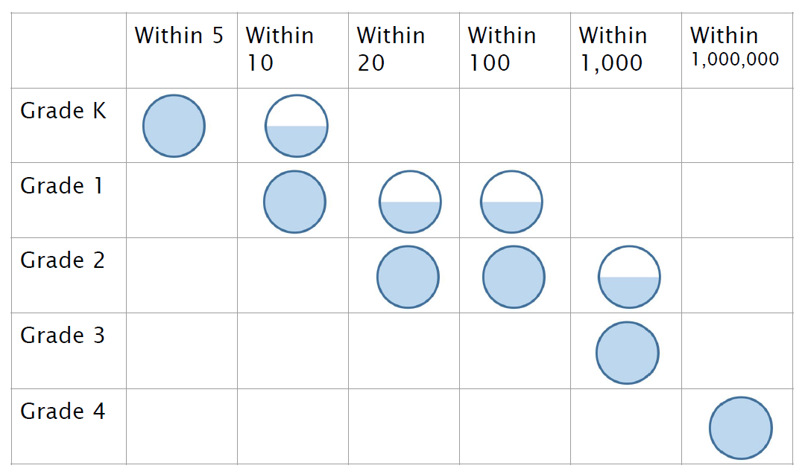
Coherence in Addition and Subtraction K-4

Slide 15
How are next generation assessments different?
Rigor: in major topics pursue conceptual understanding, procedural skill and fluency, and application with equal intensity.
From | To
Unbalanced emphasis on procedure and application | Assessment of all three aspects of rigor in balance
A lack of items that require conceptual understanding | Items that require students to demonstrate conceptual understanding of the mathematics, not just the procedures
Fluency items that are only routine and ordinary | Fluency items that are presented in new ways, as well as some that are routine
Application of mathematics to routine and contrived word problems | Application of mathematics to authentic non-routine word problems and real-world situations
Notes:
The final Shift, rigor, requires:
Equal Intensity: Balancing the three elements of rigor includes many things that assessments have done well for years, but adds the additional element of balancing these three types of questions. We have all seen questions require students to demonstrate procedural skills and fluencies. Those items are still critical, and still exist in CCSS-aligned assessments. As we will see there are even some improved item formats that help ensure that students can demonstrate this knowledge quickly and accurately. In addition, real-world application questions that require students to use mathematics to solve problems are still critical. The CCSS does emphasize the growing importance of these types of questions.
Many educators appreciate the visual of the three legged stool. All three aspects of rigor (conceptual understanding, procedural skill and fluency and application) need to be addressed for students to be able to reach the depth of learning that is expected by the CCSS.
•The three aspects of rigor are not always separate. Conceptual understanding needs to underpin fluency work; fluency can be practiced in the context of applications; and applications can build conceptual understanding.
•Nor are the three aspects of rigor always together. Fluency requires dedicated practice to that end. Rich applications cannot always be shoehorned into the mathematical topic of the day. And conceptual understanding will not come along for free unless explicitly taught.
Conceptual understanding: The Standards call for conceptual understanding of key concepts, such as place value and ratios. Rather than relying on mnemonic devices and tricks like “Please Excuse My Dear Aunt Sally” (for the order of operations) or “Ours is not to reason why, just invert and multiply,” students must show that they understand the meaning of the mathematics. There are many ways for students to show that they have conceptual understanding. In addition to explaining why a procedure works, students can demonstrate conceptual understanding by showing their work well or representing the work pictorially. Students must be able to access concepts from a number of perspectives so that they are able to see math as more than a set of mnemonics or discrete procedures.
Procedural skill and fluency: The Standards call for speed and accuracy in calculation. Students are given opportunities to practice core functions such as single-digit multiplication so that they have access to more complex concepts and procedures. New ways of presenting fluency items include placing unknowns in all positions of an equation and showing linear quadratic equations in a variety of ways.
Application: The Standards call for students to use math flexibly and authentically for applications in problem-solving contexts. The Standards also call for a variety in what students produce, leading to assessment items that ask for the answer, an explanation, or a different representation. Prior to the CCSS, most word problems were not on grade level, using numbers that fit easily into the problem. These “cooked” problems typically prompted students on which operations to use to get the answer and were often routine, following a similar format. In content areas outside of math, particularly science, students are given the opportunity to use math to make meaning of and access content.

Slide 16
Conceptual Problems
Which number is larger?
1.7 or 17 twelfths
Explain how you can tell without drawing a
picture.

Slide 17
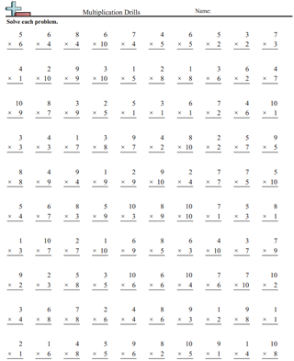
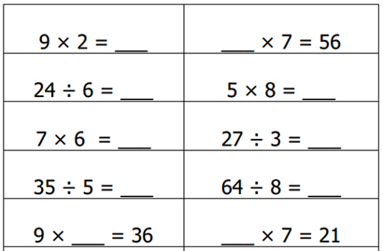
Traditional v. Next Gen approach
Notes:
Assessing Procedural Skill and Fluency: Notice that the before and after are very similar! That’s because a lot of work around procedural skill and fluency is the same. However, there are differences if you look closely.
One key difference is that the structure of the CCSS-aligned items are more intentional: unknowns are in all positions, and multiplication and division problems are mixed together.
Another key difference is that the problems are given horizontally. Vertical orientation often implies that there is paper-and-pencil calculation to be done. Practicing to become fluent with standard 3.OA.C.7 requires students to “know from memory all products of two one-digit numbers.” The horizontal orientation is meant to encourage students to use their memory and resist the urge to write calculations.
Note that fluency doesn’t mean timed questions; however, these problems would be daunting to a student relying on pictures and repeated addition to solve them. Developing fluency will help students access more complex mathematics so they’re not stuck on basic mathematics.

Slide 18
Question:
What obstacles do teachers face in adjusting to the “new” style of math assessments?
Please use the Questions tab on your control panel to respond.
Notes:
Jennie

Slide 19
Section 2: How do SAP’s mini-assessments for mathematics serve a model for high-quality, aligned assessments?
Notes:
Jennie

Slide 20
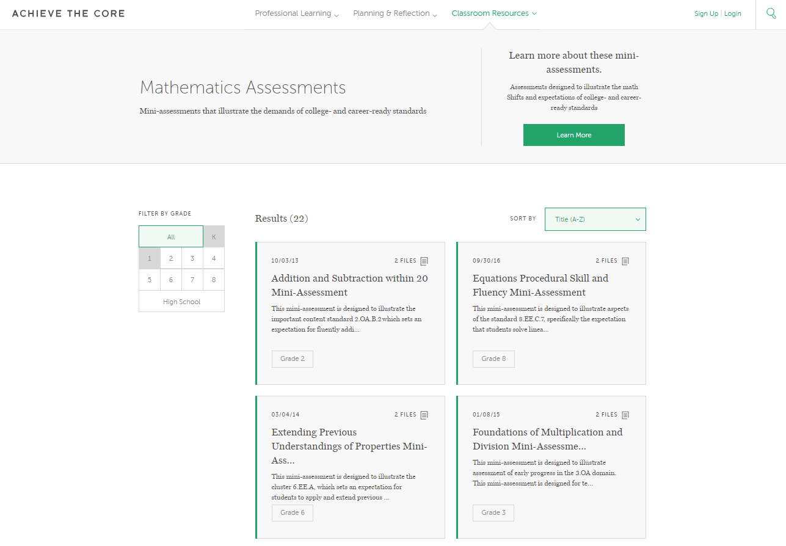
SAP Mini-Assessments on AchieveTheCore.Org
Notes:
ASTRID
SAP has created mini-assessments to help teachers better understand what high-quality assessments, whether formative, classroom, or summative, should look like.
What you are seeing here is a screenshot of the landing page for accessing these mini assessments.
If you look over to the left hand side of the screen, you see where you can filter all of these assessments by grade.
There are 22 math mini-assessments. Grades 2-8 each has three, targeting one of the three aspects of rigor: conceptual understanding, procedural skill and fluency, or application. In HS there is one mini-assessment on quadratics.
When you get the recording of the webinar, you can go to this slide and click on the link and it will take you to the mini assessment page on Achieve the Core.

Slide 21
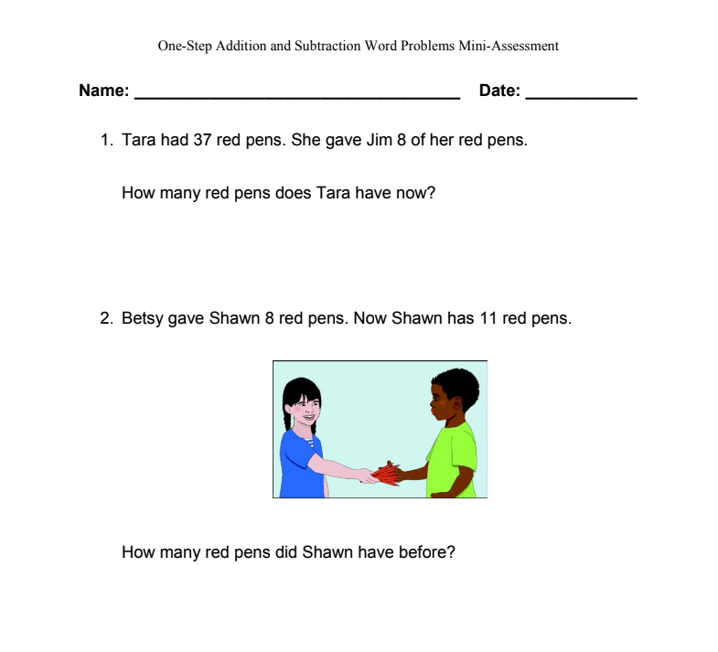
SAP Mini Assessment Example
Notes:
This screenshot shows an example of a math assessment that has been developed for grade 2. As with any mini-assessment this could be used for advanced students at a lower grade or less advanced students at a higher grade. This is the mini-assessment that Michelle will be specifically referencing later in the webinar.

Slide 22

Components with a math mini assessment
Overview (for teachers)
Making the Shifts (for teachers)
A Closer Look (for teachers)
Mini-assessment (for student)
Answer key and annotations (for teachers and/or students, depending on use case)
Links to progression documents (dependent), Focus by grade level documents (for teachers).

Slide 23
Question:
How could you use SAP’s mini-assessments in your setting to improve alignment to high-quality assessment?
Please use the Questions tab on your control panel to respond.
Notes:
Jennie

Slide 24
Section 3: How have educators used the mini-assessments in their settings?
Notes:
Jennie

Slide 25
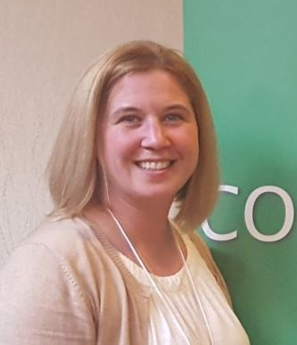
Michelle Douglas-Meyer
Instructional Coach
Milwaukee, Wisconsin
Notes:
Janelle

Slide 26
Mini-Assessments in a Professional Learning Setting
School level observations highlighted a struggle with the following standards: K.OA.2, 1.OA.1, 2.OA, particularly in the more challenging formats for their grade.
Analysis of our curricular materials also showed fewer opportunities for students to engage regularly in a variety of problem types.

Slide 27
A Process
1
Take the assessment
2
Study the content
3
Analyze the structure
4
Plan

Slide 28

1
Take the assessment
Teachers took the assessment independently.
As a group, discussed sticky points.
Notes:
In planning for the meeting…
completed the mini-assessment myself.
predicted where teachers might struggle
reviewed the problem types chart
reviewed structures of tape diagrams
studied structures of the problems presented in the mini assessment
During the PLC
Teachers were given only the assessment - pages 5-12 in the pdf version on the SAP website. Everyone completed the assessment independently.
Once we completed the assessment, we went over the answers. It was important that teachers felt safe to discuss the problems they struggled with - some of the problems require careful thought. This naturally led to an examination of the standards (K.OA.2, 1.OA.1, 2.OA.1) and the problem types chart from the appendix of the CCSS.

Slide 29
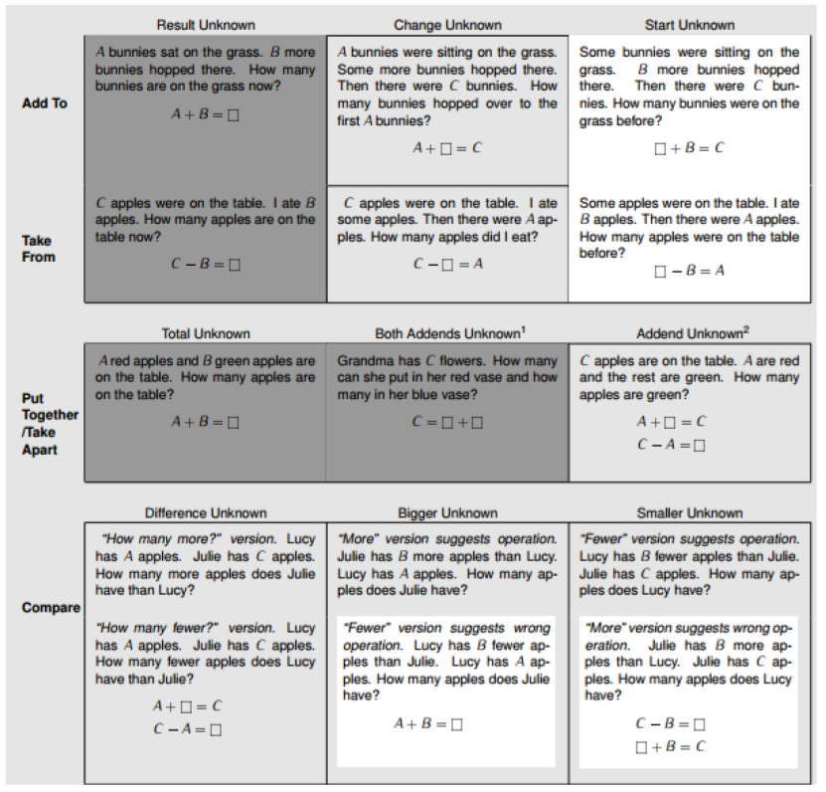
2
Study the content
Notes:
As we talked through the chart (we had previously studied the chart so this was mostly a refresher), we discussed the differences between each row (add to/take from vs put together/take apart vs compare problems) and each column (the location of the unknown). We went through each problem on the mini assessment and matched it to the corresponding problem type on the chart. There were a few misteps, but as we talked through why each problem fit into each problem type, teachers reached a deeper understanding of the various situations.

Slide 30

2
Study the content
}
Add to/Take From and
Put Together/Take Apart
whole
part part
Compare Problems
difference
smaller quantity
larger quantity
Notes:
A second piece of content that we discussed related to word problems was not explicitly on the assessment. As we worked to make sense of the problems, however, we found that some kind of representation was helpful. This led us to a discussion of how tape diagrams provide a visual representation of the relationships between the quantities in a given problem. Tape diagrams are referenced in the Progressions documents as a representation that “lasts” - meaning students can continue to use them from early on with whole number operations to later work with fractions as well as with ratio work in middle school.

Slide 31
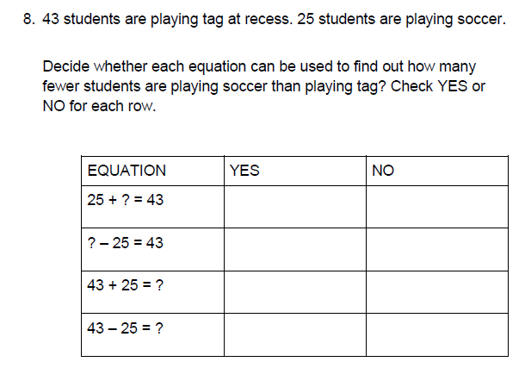
3
Analyze the structure
Notes:
We then discussed the structure of some of the assessment items or the formatting of the assessment independent of the content. A questions from the assessment that we discussed…
In this problem, students are asked to consider all the equations that could be used to solve the problem, not only the problem they themselves would use. As one teacher commented as we examined this problem, “Students must shift their thinking from how they alone might solve the problem to how others might also solve the problem –that’s really difficult!” The mini assessment allowed teachers to see alternative ways that they might format word problems to their students to connect to MP3, and a encourage a deeper understanding in their students. We engaged in a discussion of

Slide 32
4
Plan
Next steps for instruction and planning:
Analyze problems presented in curriculum
  Which problem types are missing or less frequent?
  How could we adjust given problems to change the problem to give students access to more challenging types of problems?
Consider the format of the problems presented to students
  What adjustments might we make to push students to think deeper about the problem than just solving?

Slide 33
Additional uses for mini-assessments
A quick pulse check of how students are progressing on grade-level content. Are they struggling with their mathematical fluency? If so, administer a fluency mini-assessment at multiple times throughout the year to gather timely information.
You want to expose your students to various formats of questions they might encounter on a summative assessment. The mini-assessments include types to serve this purpose.
Are students not really understanding why their responses were correct or incorrect? Although we don’t encourage test prep, it might be helpful for students to see the annotations at the end of the mini-assessments.
Notes:
Astrid

Slide 34
Questions for our Guests?
Notes:
How do I use the assessments for English Language Learners?
Are there others that fit with Michelle’s process to build teacher content knowledge?
Why are there no K-1 assessments?

Slide 35
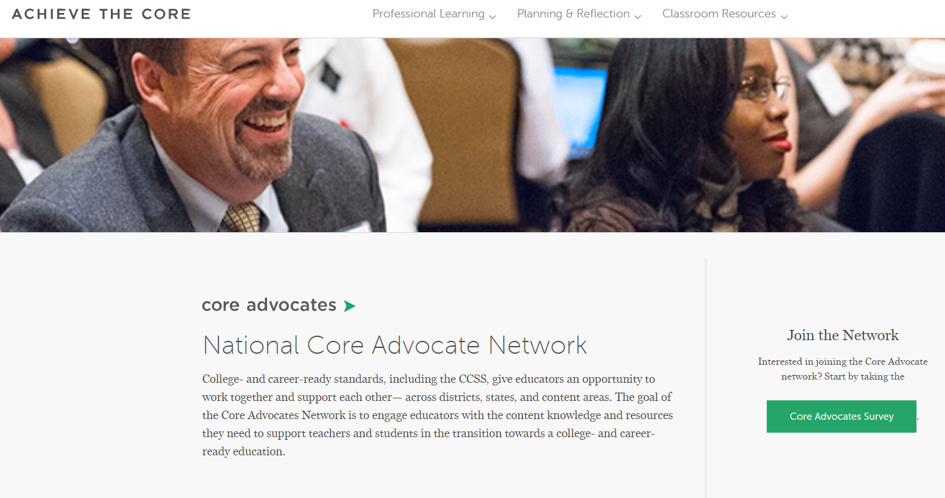
Join our network!
www.achievethecore.org/ca-signup
Notes:
Jennie
If you found tonight’s webinar helpful, we’d like to invite you to join our Core Advocate network! We’re committed to solving real problems that real teachers have and we know the best way to do this is to know more about what folks are experiencing.
We’d love to learn about who you are, where you work, the types of things you’re interested in and the expertise you already have. This way, we will be able to tailor our webinars and other opportunities to your needs and interests (we may even tap you to be our next webinar panelist). So we encourage you to join the network by filling out this survey completely at atc.org/ca-signup

Slide 36
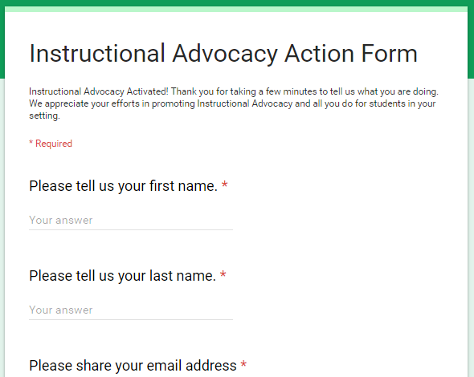
Tell us about your efforts
www.achievethecore.org/educators-taking-action
Notes:
Jennie
We like to invite Core Advocates to share what they are doing more broadly. Whether its you trying a strategy or a tool, we’d like to know how it went. Please let us know about your advocacy with our IAAF.

Slide 37
Please join us again!
July Webinar:
The Problem of Teaching Literacy Backwards
SAP Guest: David Liben
Wednesday, July 11, 7:00 - 8:00 p.m. ET
Register Here: https://register.gotowebinar.com/register/1958361441732587779
August Webinar:
Don't Make Every Math Strategy a Separate Lesson: Developing Understanding and Skill with K-4 Operations
SAP Guests: Marni Greenstein and Shelbi Cole
Wednesday, August 8, 7:00 - 8:00 p.m. ET
Register Here:
https://attendee.gotowebinar.com/register/8508311637580332547
Notes:
Jennie

Slide 38
Thank You!
Notes:
Janelle

